Slide 1
Grapevine/La Vina
General Service Conference Advisory Action, 1986: “Since each issue of the Grapevine cannot go through the Conference-approval process, the Conference recognizes the AA Grapevine as the international journal of Alcoholics Anonymous.”
Our meeting in Print

Slide 2
A brief History Of Grapevine
Since 1944
Inspired by a newsletter from the Cleveland, Ohio Group, some New York area AA’s approached AA co-founder Bill W. about starting a newsletter. He gives the idea his blessings and plans proceed.

Slide 3
Grapevine in Other Country’s
AA in Five Languages
Around the world, the setting may be different but the message is the same

Slide 4
In Every Issue
Letter from the Editor
Dear Grapevine
AA News
Discussion Topic
At Wit's End
Alcoholism at Large

Slide 5
Also In Every Issue
The AA Preamble
The Twelve Steps
The Twelve Traditions
The Serenity Prayer
The Responsibility Declaration
The AA Grapevine Statement of Purpose

Slide 6
Books

Slide 7
More Books

Slide 8
So Much To Offer
SOBRIETY CALCULATOR
Grapevine Back Issues
CD’s
COUNT YOUR DAYS
2 Years
778 Days
18,677 Hours
1,120,627 Minutes
67,237,629 Seconds

Slide 9
Subscriptions and Gift subscriptions
Grapevine Subscriptions
Gift Subscriptions
Gift Certificate
US
Canada
International
La Viña Suscripciones
Grapevine Gift Subscriptions
Carry the Message Gift Certificate
Grapevine ePub Subscriptions

Slide 10
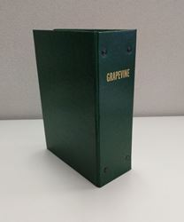
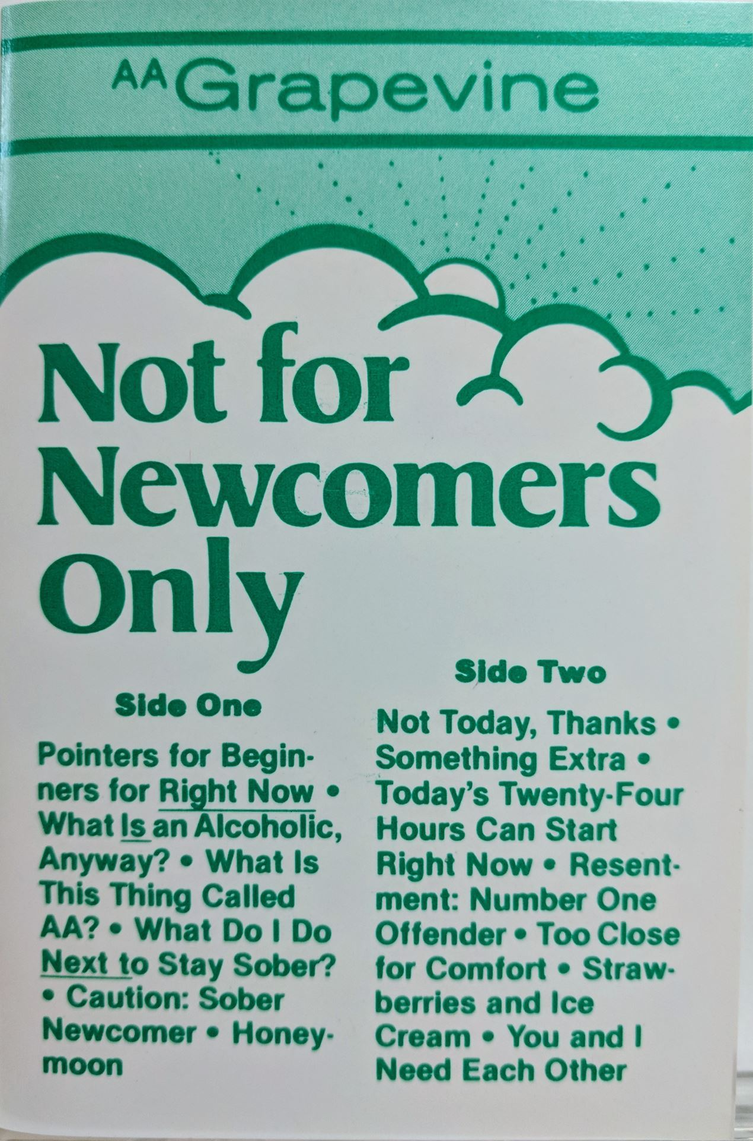
Grapevine/La Vina Store: So Much o Offer
E Books
Calendars
A Variety of
Other
Products
Cassette

Slide 11
Contact Us
Grapevine/La Vina:
www.aagrapevine.org
Area 56 Grapevine Committee Chair:
spirituallyfitina56@yahoo.com
(800) 631-6025

